Slide 1
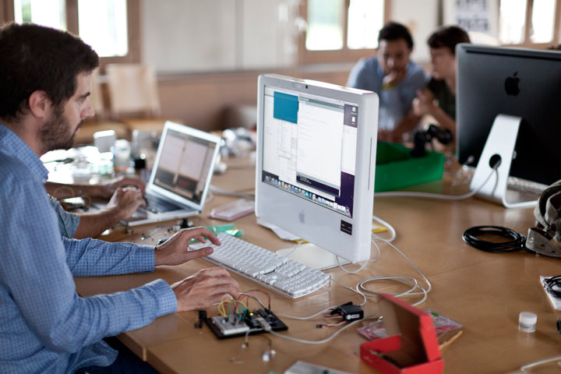

What is FAMILIAR to Us?
Smart Pillow

Slide 2

Contents
Ⅰ. Outcome
Ⅱ. Function
Ⅲ. Code
Ⅳ. Disadvantages
Ⅴ. Advantages
Ⅵ. Unexpected Progress
Ⅶ. Alternatives

Slide 3
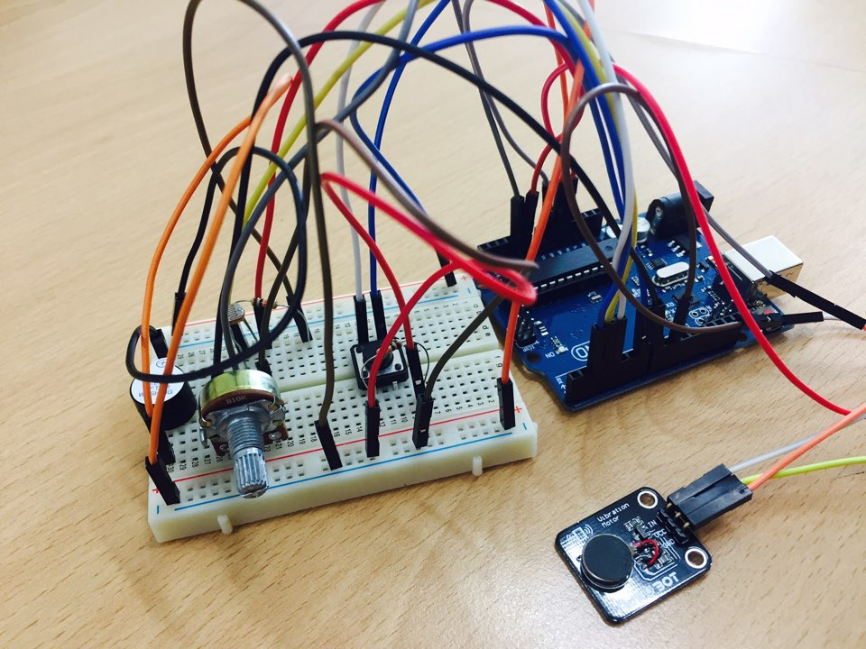
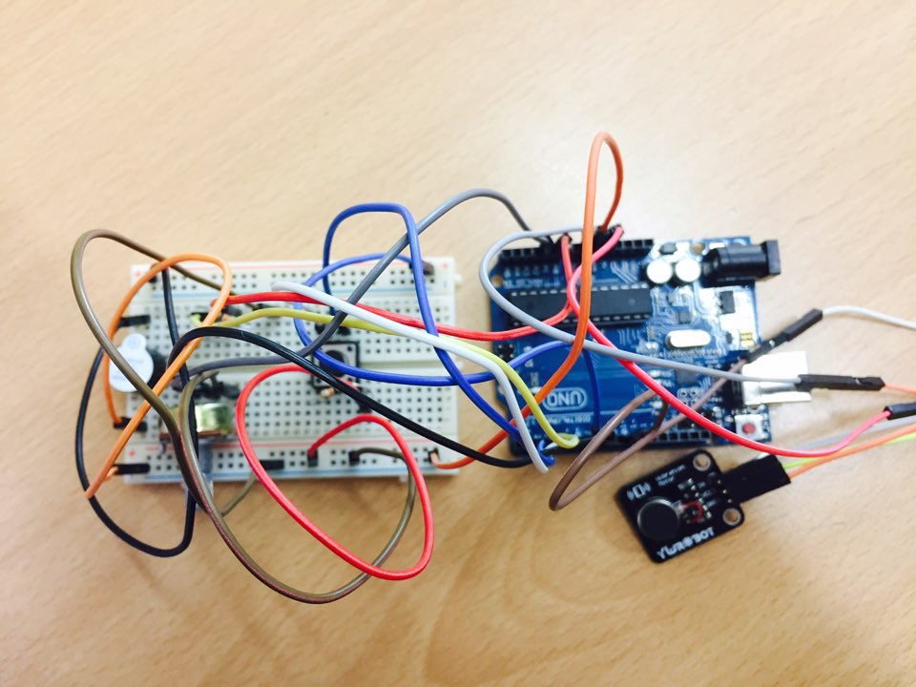
Outcome

Slide 4
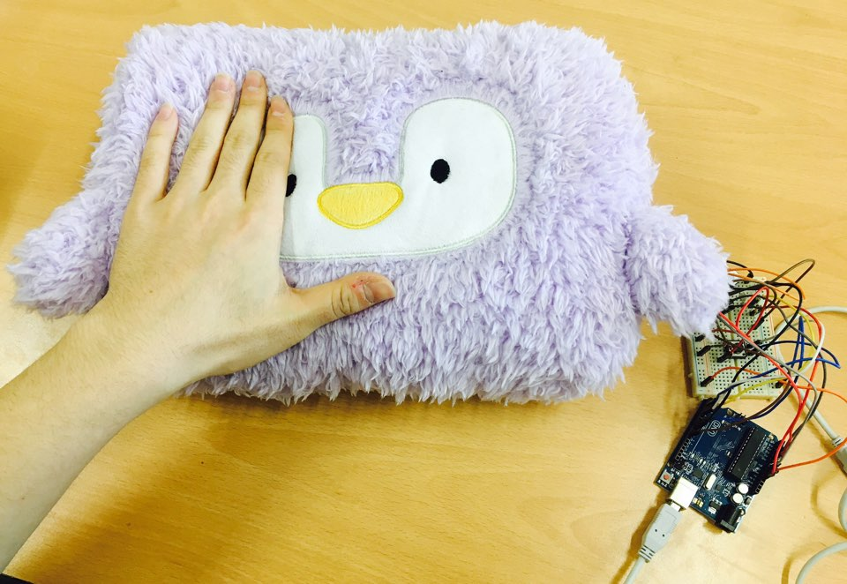

Outcome

Slide 5
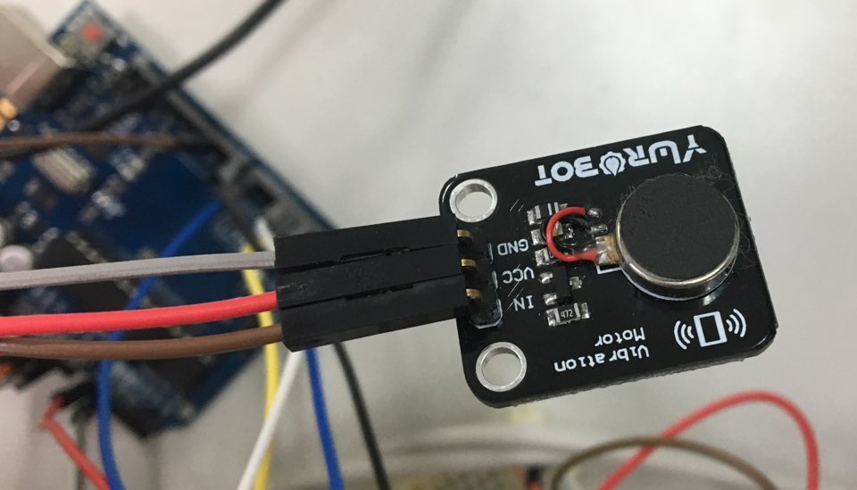
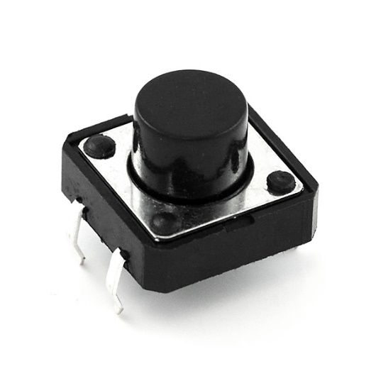
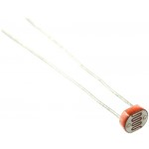
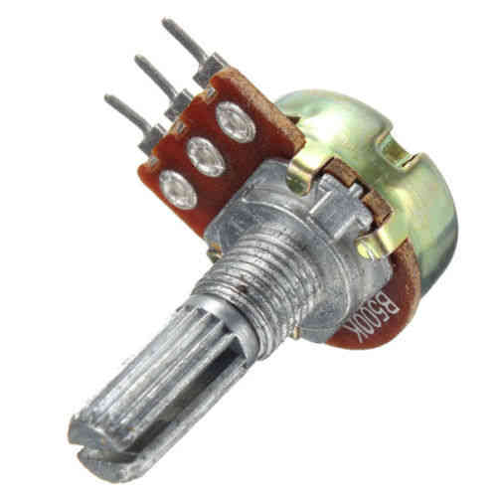
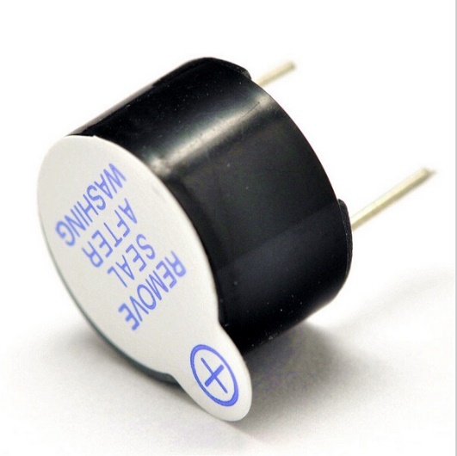
Funtions
1. Vibrator Sensor
2. Push Button
3. Light Sensor
4. Buzzer
5. Potentiometer

Slide 6
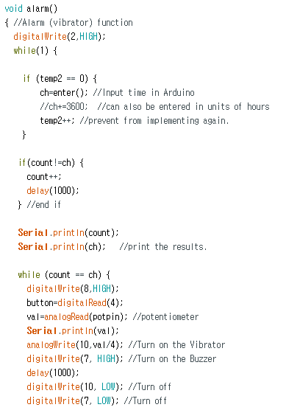
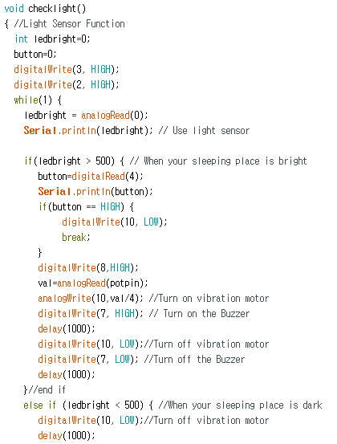
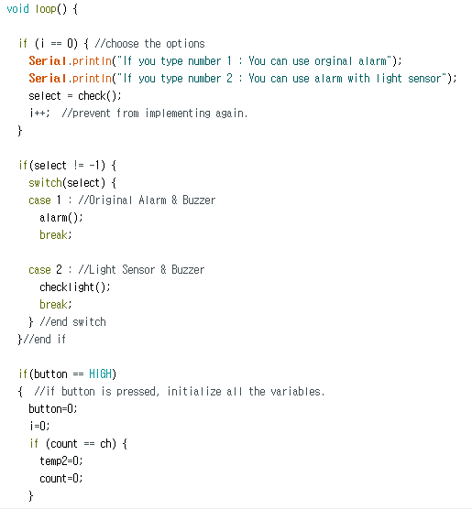
Code
Alarm
Checklight
Loop

Slide 7
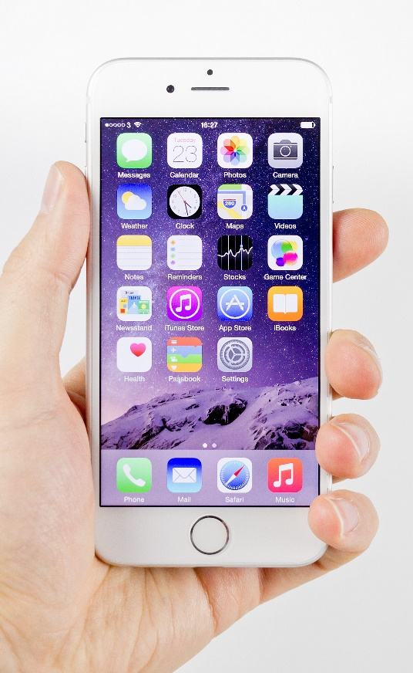
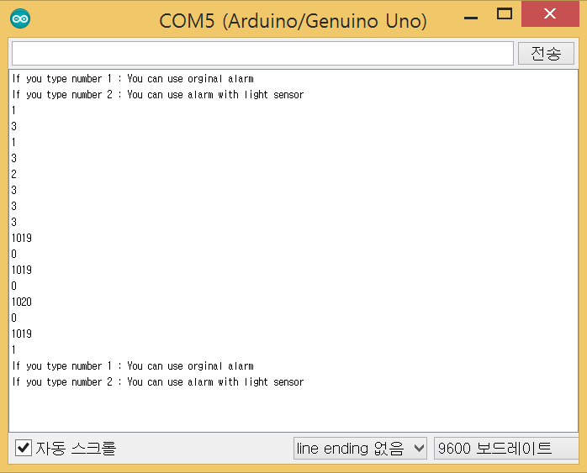

Disadvantages
Planned to be interlocked with Smart Phone
Use Serial Board!

Slide 8

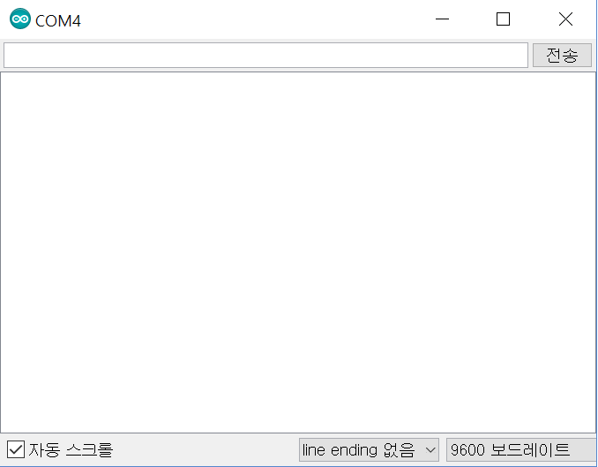

Disadvantages
Limitation of Serial Board
Only
one digit
can be entered!

Slide 9

Advantages
1. Immediately usable
2. easy to connect Arduino
with daily life.
CONVENIENCE

Slide 10

Advantages
3. almost SAME
with the first time we’ve planned
4. additional features
are able to be adjusted.
FAMILIAR

Slide 11

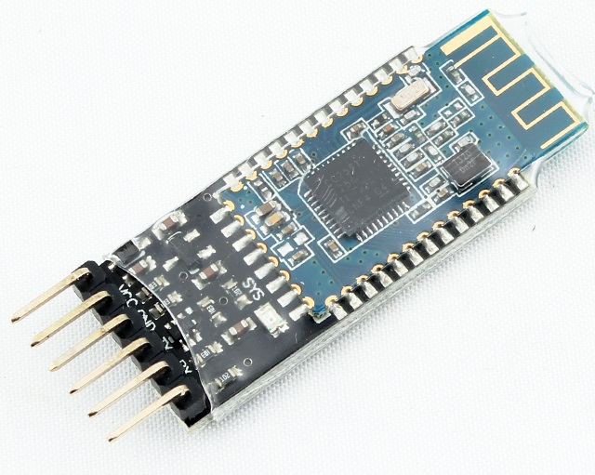
Unexpected Progress
Original Plan
Use functions
we didn’t learned in class
Vibration motor
Bluetooth Sensor

Slide 12

Alternatives
Changed Result
Added other functions
Apply most of the functions
we learned in class

Slide 13
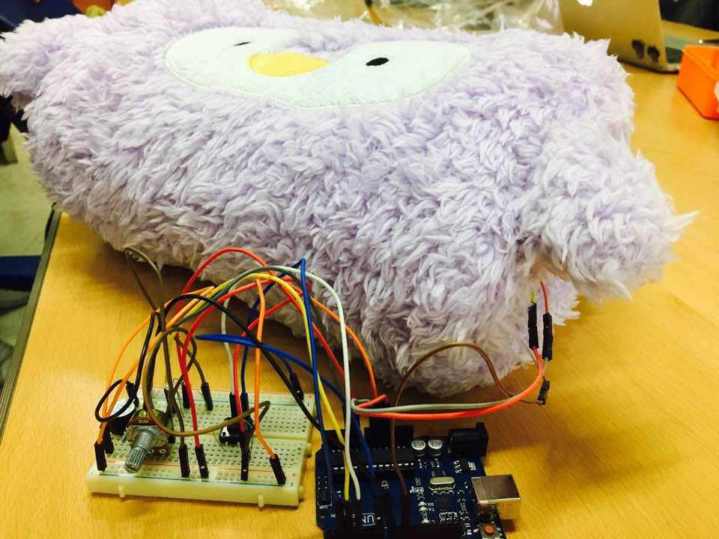
Thank You

